Slide 1

29 April 2021
Radford Burger

Slide 2
Agenda
Implementing a Stack using a Linked List
What’s next? → Queues
  Implementing a queue using an array

Slide 3
What is a stack?
A stack is a linear data structure that contains elements , with a sequence and an
order as to how it is constructed and traversed.
If we wanted to add or remove elements from it, we’d have to do it starting from one place:
→ the top of the stack.

Slide 4
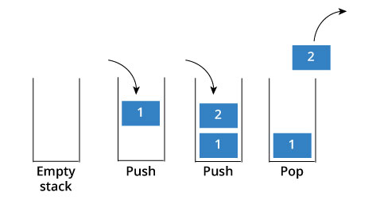
What is a stack?
Stack is a special kind of data structure that follows strategy.
This means that the element that is added to stack last will be the first to be removed
Conversely, this also means that the first element that you put into the stack will always end up being the last one that goes out.
Last-In-First-Out (LIFO)
Example:
As we navigate from web page to web page, the URL of web pages are kept in a stack, with the
current page URL at the top. If we click back button, then each URL entry is popped one by one.

Slide 5

Stack operations
push(k):
Adds a new item to the top of the stack
Remove an element from the top of the stack and return its value.
Returns the value of the element at the top of the stack, but does not remove it
Returns the number of elements in the stack
determines whether the stack is empty. It returns 1(true) if the stack is empty or returns 0 (false) in all other cases.
Note: All the above Stack operations are implemented in Time Complexity.
pop( ):
top( ) or peek( ):
size( ):
isEmpty( ):
O(1)

Slide 6
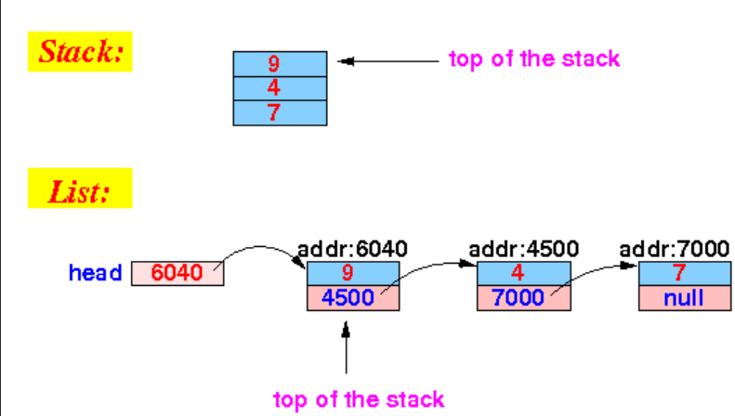
Implementing a Stack using a Linked List

Slide 7
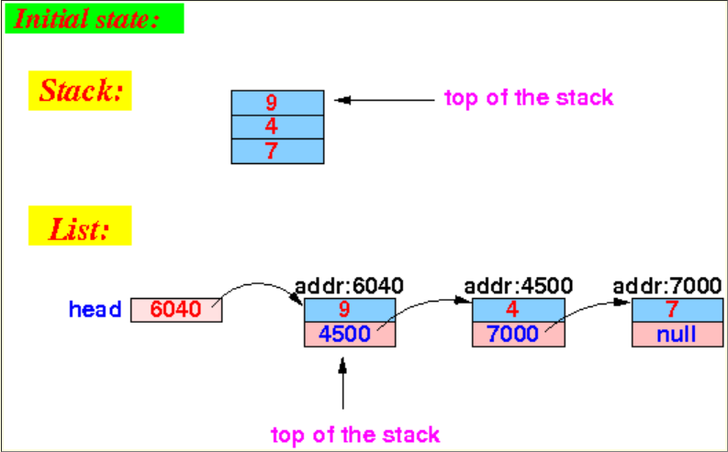
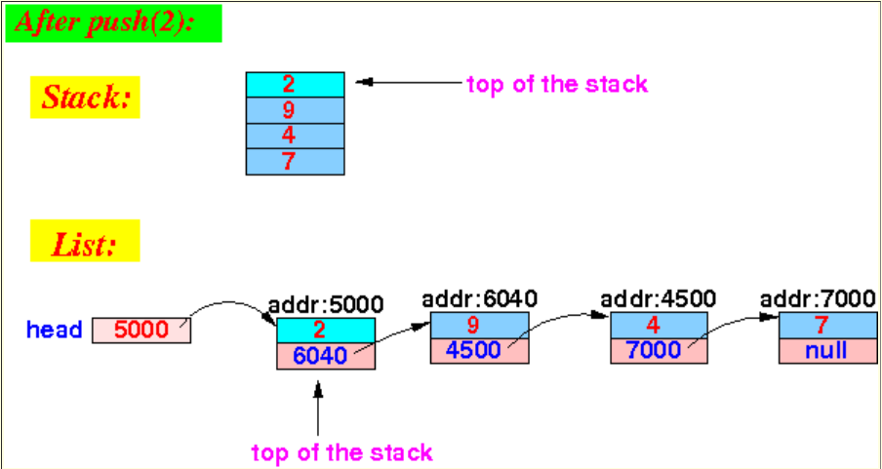
Effect of the push( ) operation
push(x) is equivalent to inserting at head in a list

Slide 8
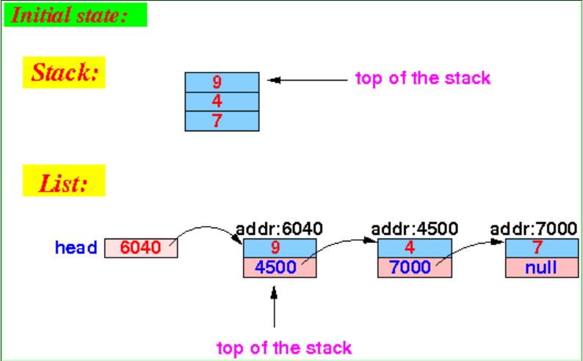
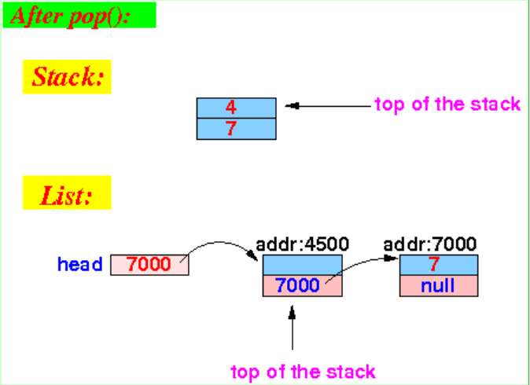
Effect of the pop( ) operation
pop() is equivalent to deleting at head in a list

Slide 9
Let’s look at some code
Array implementation | Linked List implementation
public class Stack {
private static final int CAPACITY = 1000;
private int[ ] data;
private int top = -1;
public Stack( ) {
this(CAPACITY);
}
public Stack(int capacity) {
data = new int[capacity];
}
}
public class Stack {
private static class Node {
private int value;
private Node next;
public Node( int v, Node n) {
value = v;
next = n;
}
}//end class Node
private Node head = null;
private int size = 0;
//Other Methods
}//end class Stack

Slide 10
The push() function algorithm
Simply insert at the head of the linked list.
Memory is created for one node.
Then the value is stored into that node.
The node is inserted at the beginning of the list.
Size of stack is incremented.

Slide 11

Java for the push( ) function
public void push(int value) {
head = new Node(value, head);
size++;
}

Slide 12
The pop( ) function algorithm
Simply delete from head of the linked list.
Check if stack is empty.
The head of the linked list starts pointing to the second node there by releasing the memory allocated to the first node.
Size of stack is decremented.
Return the removed value

Slide 13
Java for the pop( ) function
public int pop( ) throws IllegalStateException{
???????????????
???????????????
???????????????
}

Slide 14
The peek() function algorithm
returns the value stored at the beginning of the list (does not remove it)

Slide 15
The print() function
The print function will print all the elements of the list.
public void print( ){
???????????????
???????????????
}

Slide 16
In your main method
· The user of the stack will create a stack local variable.
· Use push() and pop() functions to add / remove variables to/from the stack.
· Read the top element using the peek() function call.
· Query regarding size of the stack using size() function call
· Query if stack is empty using isEmpty() function call

Slide 17
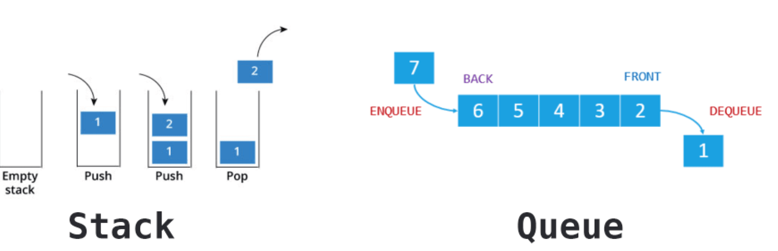
What’s next? Queues

Slide 18

What is a Queue?
The real life analogy of queue :
· We wait in a line of railway reservation counter.
· We wait in the cafeteria line (to pop a plate from “stack of plates”).
· We wait in a queue when we have to pay for shopping items.

Slide 19
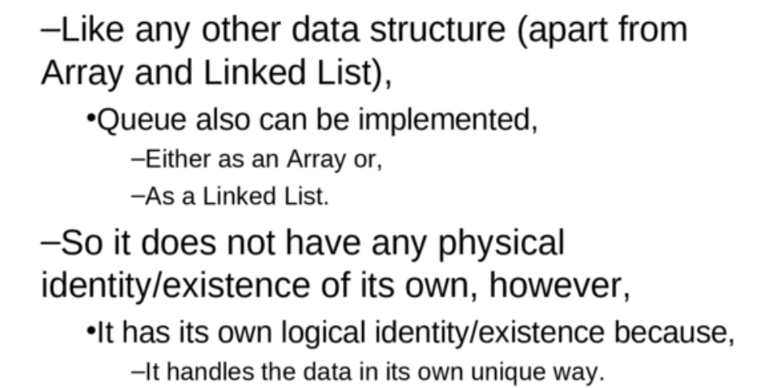
What is a Queue?

Slide 20
What is a Queue?
A queue is a basic data structure that organizes items in first-in-first-out (FIFO) manner.
First element inserted into a queue will be the first to be removed. It is also known as "first-come-first-served".
The elements which are at the back of the queue, are the ones that stay in the queue for the longest time.

Slide 21
Example of Queues?
We issue a print command from our office to a single printer per floor.
The print task gets lined up in a printer queue.
Additional print tasks are lined up at the back of the queue.
The print command that was issued first will be printed before the tasks that were requested later.

Slide 22
Queue operations
add(): Which adds a single element at the back of a queue
remove(): Which removes a single element from the front of a queue.
peek() or first() : examine front element without removing it
isEmpty(): Returns 1(true) if the queue is empty
size(): Returns the number of elements in a queue.

Slide 23
Queue operations
add(): Which adds a single element at the back of a queue
Also known as: Enqueue
remove(): Which removes a single element from the front of a queue.
Also known as: Dequeue (verb)
Please note!!
This is not the same as Deque (noun, pronounced ‘deck’):
Double-ended queue, where you can remove from the back and the front of the queue

Slide 24
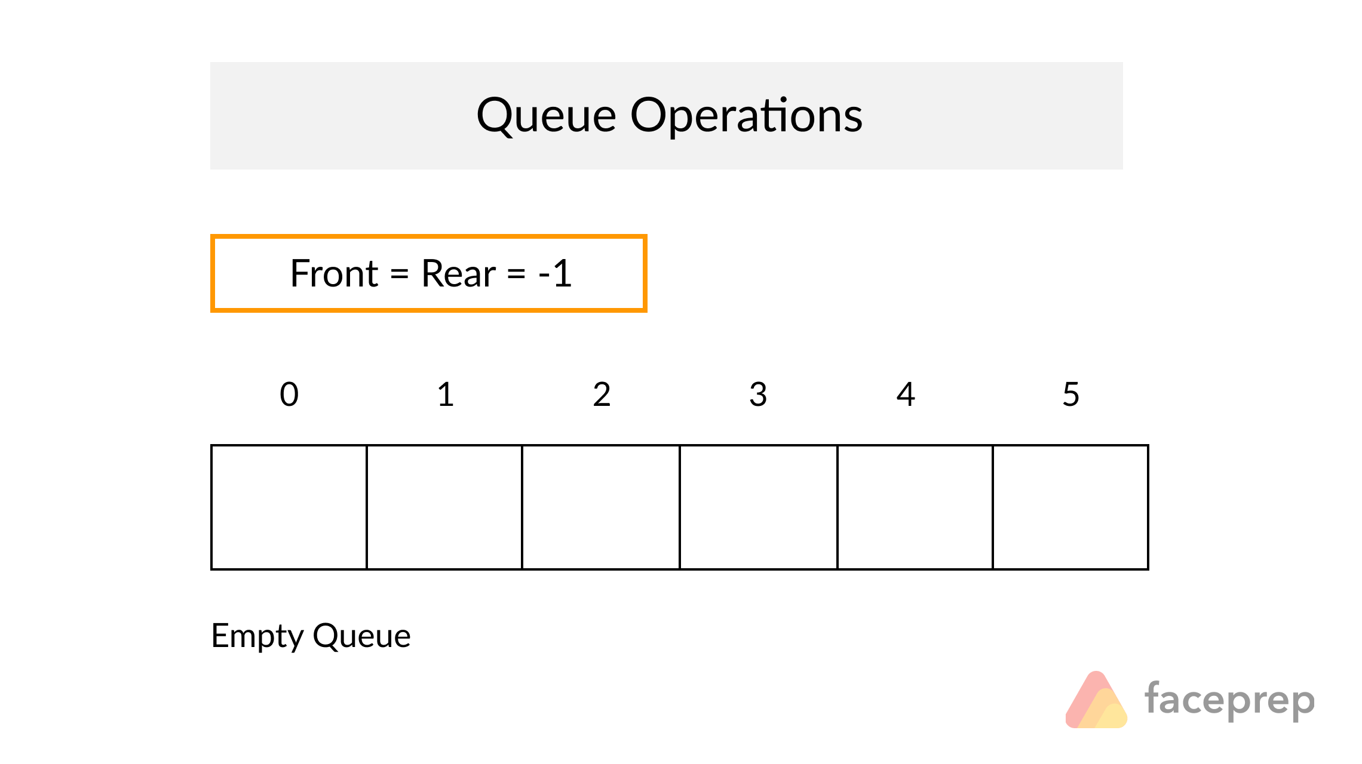
Queue using Array

Slide 25
Queue using Array
public class Queue {
private int size;
private int Capacity=10;
private int[] data;
int front=0;
int back=-1;
public Queue() {
size = 0;
data = new int[Capacity];
}
}//end class
Set number of elements in queue to zero.
Set front of queue to zero.
Set back of queue to -1.

Slide 26
Algorithm to Add element to Queue array
Add() : insert one element at the back of the queue.
If the queue is full
  then return false
else
  increment size
  Increment back
  Assign element to array
Return true

Slide 27
Algorithm to Remove element from Queue array
Remove() : delete one element from the front of the queue.
If the queue is empty
  then return -999
else
  decrement size
  Assign element to be removed to integer variable
  increment front
return element

Slide 28
What’s next?
Array implementation of queue:
https://www.youtube.com/watch?v=okr-XE8yTO8&t=35s
/watch?v=okr-XE8yTO8&t=35s
Is enqueue operation O(1) or O(n) time complexity?
Is dequeue operation O(1) or O(n) time complexity?
Next: Implementing a Queue using a Linked List

Slide 29

Date will change due to Eid
Class test: Thursday13 May 2021 ????
Doubly and circular Linked Lists
Stacks
Queues

Slide 30
Date will change due to Eid
Class test: Thursday13 May 2021 ????
Class reps to respond to me by tomorrow (Fri 30 April)
Lonwabo Magazi
Titilayo Nikelwa
Trevor Ngcobo
Elvis Ndlangamandla

